Slide 1

EatEasy | Data-X
Dhruv Madaan
Jessica Kam
Jennifer Chen
Pouriya Bagheri
December 5, 2017

Slide 2
Agenda
Problem Statement
Intended User Interface
Approach to Problem
Architecture of Solution
Learning Path

Slide 3

What is the problem?
What is the best dish you have here?

Slide 4
What is the problem?
Everything is good here!

Slide 5
What is the problem?
Well that is not helpful.

Slide 6
What is the problem?
I wish there was something to tell me what is actually good here...

Slide 7


Project Overview
Competitors
Suggest what food item a user should get at a particular establishment based on their preferences

Slide 8
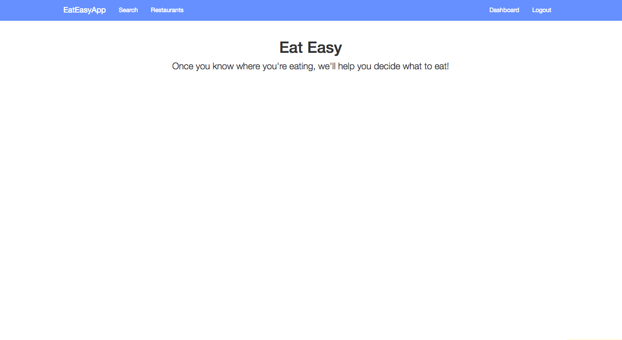
User Interface
USER INTERFACE
APPROACH
ARCHITECTURE
LEARNING PATH

Slide 9
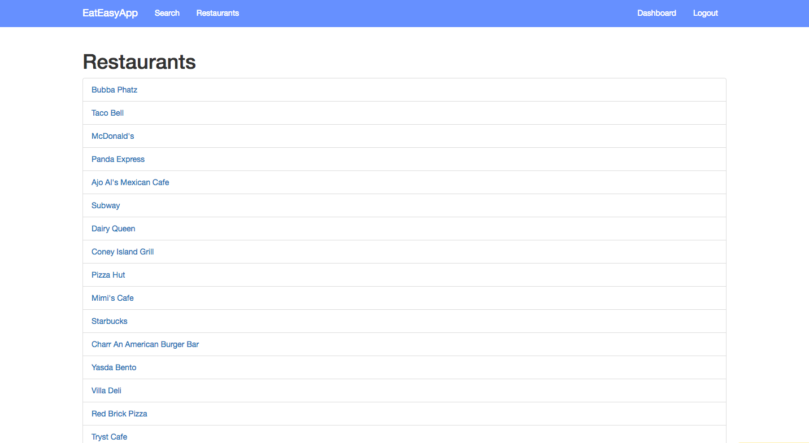
User Interface
USER INTERFACE
APPROACH
ARCHITECTURE
LEARNING PATH

Slide 10
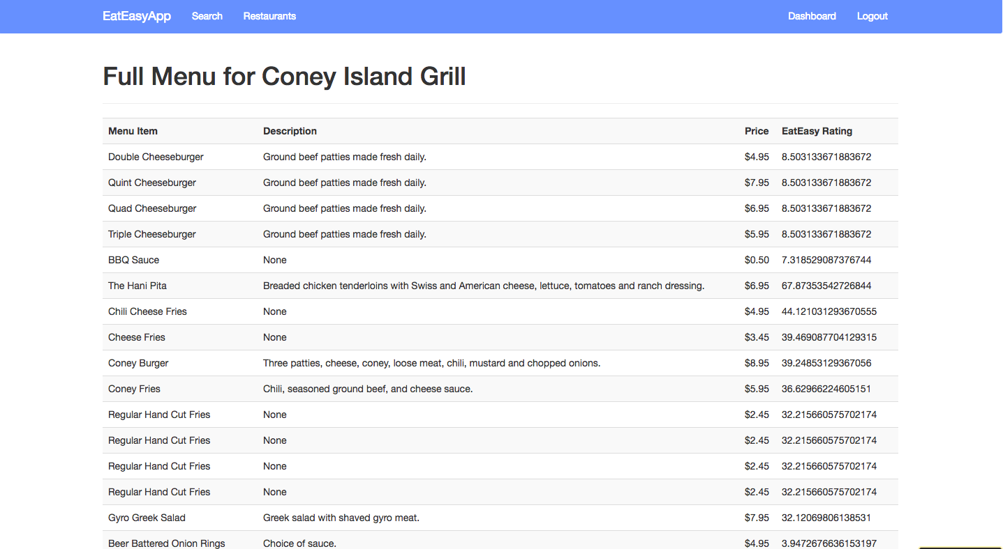
User Interface
USER INTERFACE
APPROACH
ARCHITECTURE
LEARNING PATH

Slide 11
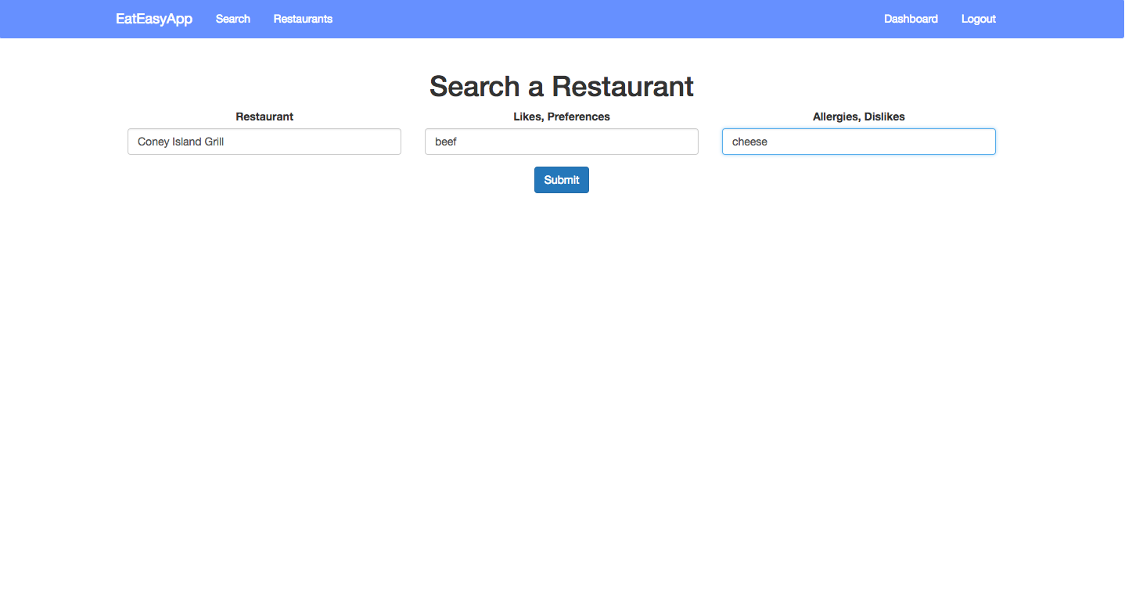
User Interface
USER INTERFACE
APPROACH
ARCHITECTURE
LEARNING PATH

Slide 12
Demo!
Notes:
Red Brick Pizza: pizza, pineapple
one of their pizzas
Funky Food Shack: sandwich, ham
one of the sandwiches
Coney Island Grill: beef, cheese
one of their burgers

Slide 13
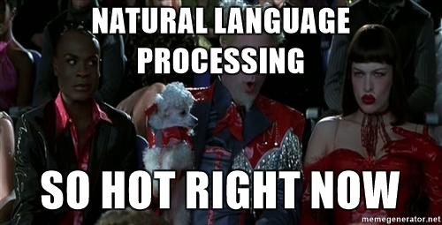

Demo
Approach
Approach
Eat Easy
UI
APPROACH TO PROBLEM
ARCHITECTURE
LEARNING PATH

Slide 14
Different Stages of the Project
Scrape All Menus
Clean Yelp Dataset
Algorithm Development
Final Solution
Research Methods for NLP
Front End Development
Real Time Hosting
UI
APPROACH
ARCHITECTURE OF SOLUTION
LEARNING PATH
Notes:
Scrape web for menu of restaurants algorithm:Search menu items in reviews Run NLP to figure out if good or bad Rank dishes based on sentiment.
Input: Restaurant Name User Preferences.
Filter: Restaurant Name User Preferences.
Output : Table of dishes person should get

Slide 15
Architecture of Solution
Algorithm
Feedback
Input
Filtering
Output
UI
APPROACH
ARCHITECTURE OF SOLUTION
LEARNING PATH
Notes:
Scrape web for menu of restaurants algorithm:Search menu items in reviews Run NLP to figure out if good or bad Rank dishes based on sentiment.
Input: Restaurant Name User Preferences.
Filter: Restaurant Name User Preferences.
Output : Table of dishes person should get

Slide 16
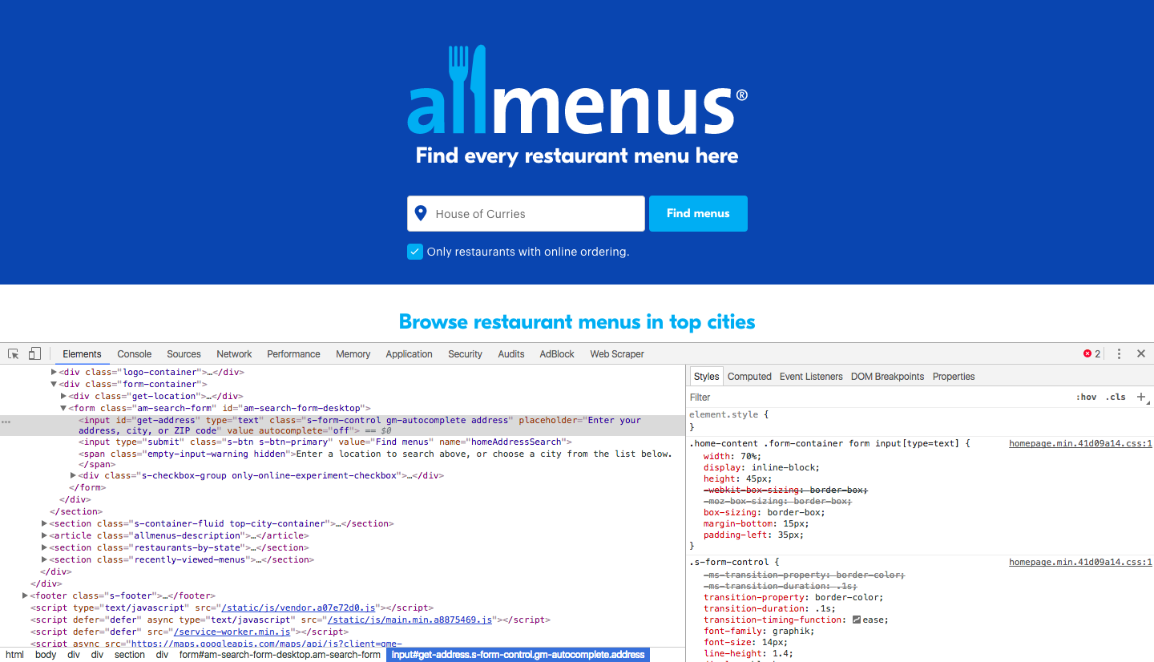
Scraping AllMenus
UI
APPROACH
ARCHITECTURE OF SOLUTION
LEARNING PATH
Notes:
Scrape web for menu of restaurants algorithm:Search menu items in reviews Run NLP to figure out if good or bad Rank dishes based on sentiment.
Input: Restaurant Name User Preferences.
Filter: Restaurant Name User Preferences.
Output : Table of dishes person should get

Slide 17
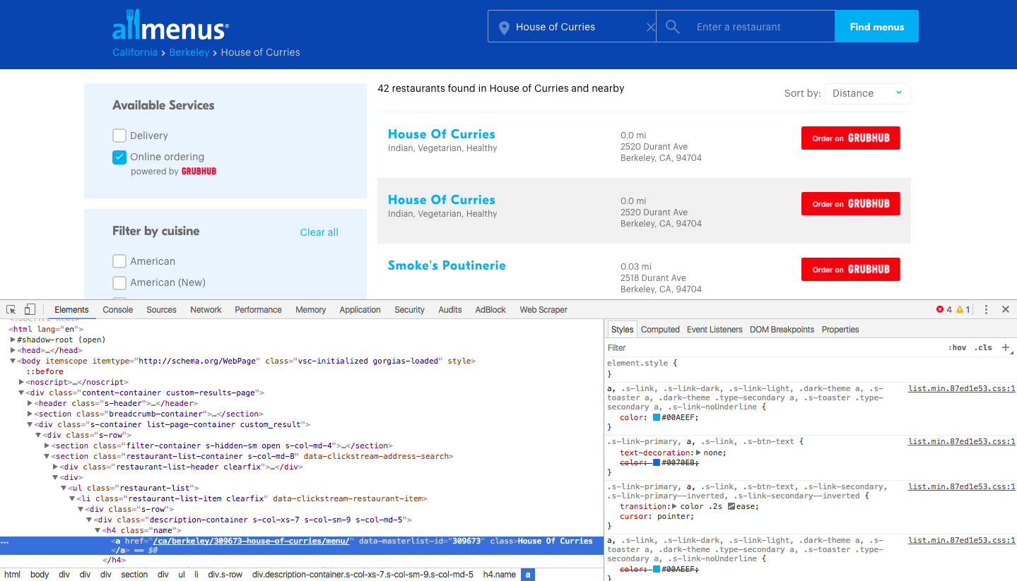
Scraping AllMenus
UI
APPROACH
ARCHITECTURE OF SOLUTION
LEARNING PATH
Notes:
Scrape web for menu of restaurants algorithm:Search menu items in reviews Run NLP to figure out if good or bad Rank dishes based on sentiment.
Input: Restaurant Name User Preferences.
Filter: Restaurant Name User Preferences.
Output : Table of dishes person should get

Slide 18
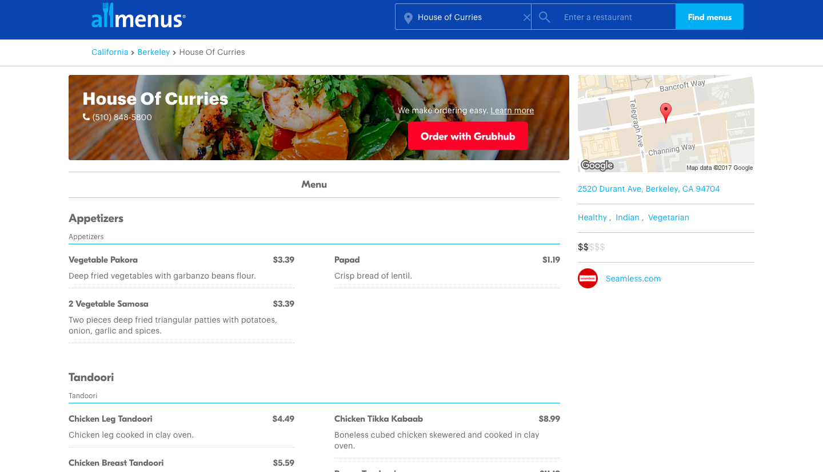
Scraping AllMenus
UI
APPROACH
ARCHITECTURE OF SOLUTION
LEARNING PATH
Notes:
Scrape web for menu of restaurants algorithm:Search menu items in reviews Run NLP to figure out if good or bad Rank dishes based on sentiment.
Input: Restaurant Name User Preferences.
Filter: Restaurant Name User Preferences.
Output : Table of dishes person should get

Slide 19
Scraping AllMenus
UI
APPROACH
ARCHITECTURE OF SOLUTION
LEARNING PATH
Notes:
Scrape web for menu of restaurants algorithm:Search menu items in reviews Run NLP to figure out if good or bad Rank dishes based on sentiment.
Input: Restaurant Name User Preferences.
Filter: Restaurant Name User Preferences.
Output : Table of dishes person should get

Slide 20
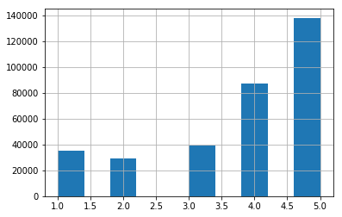
Cleaning Yelp Dataset
6 GB
Data File Size
4,546
Number of food establishments in Phoenix, AZ
328,901
Number of Reviews
UI
APPROACH
ARCHITECTURE OF SOLUTION
LEARNING PATH
Notes:
Scrape web for menu of restaurants algorithm:Search menu items in reviews Run NLP to figure out if good or bad Rank dishes based on sentiment.
Input: Restaurant Name User Preferences.
Filter: Restaurant Name User Preferences.
Output : Table of dishes person should get

Slide 21
ANALYTIC MODELS
Cleaning Yelp Dataset
Business
Hours
Friend
Review
Check-in
User
Category
Elite Years
Photo
Attribute
Tip
UI
APPROACH
ARCHITECTURE OF SOLUTION
LEARNING PATH
Notes:
Scrape web for menu of restaurants algorithm:Search menu items in reviews Run NLP to figure out if good or bad Rank dishes based on sentiment.
Input: Restaurant Name User Preferences.
Filter: Restaurant Name User Preferences.
Output : Table of dishes person should get

Slide 22
ANALYTIC MODELS
Cleaning Yelp Dataset
Business
Hours
Friend
Review
Check-in
User
Category
Elite Years
Photo
Attribute
Tip
UI
APPROACH
ARCHITECTURE OF SOLUTION
LEARNING PATH
Notes:
Scrape web for menu of restaurants algorithm:Search menu items in reviews Run NLP to figure out if good or bad Rank dishes based on sentiment.
Input: Restaurant Name User Preferences.
Filter: Restaurant Name User Preferences.
Output : Table of dishes person should get

Slide 23
ANALYTIC MODELS
Cleaning Yelp Dataset
Review
Business
Category
Attribute
Tip
UI
APPROACH
ARCHITECTURE OF SOLUTION
LEARNING PATH
Notes:
Scrape web for menu of restaurants algorithm:Search menu items in reviews Run NLP to figure out if good or bad Rank dishes based on sentiment.
Input: Restaurant Name User Preferences.
Filter: Restaurant Name User Preferences.
Output : Table of dishes person should get

Slide 24
Scrapping All Menus
Combining Yelp Dataset with Allmenus
Review
Menu
Business
Category
Attribute
Tip
UI
APPROACH
ARCHITECTURE OF SOLUTION
LEARNING PATH
Notes:
Scrape web for menu of restaurants algorithm:Search menu items in reviews Run NLP to figure out if good or bad Rank dishes based on sentiment.
Input: Restaurant Name User Preferences.
Filter: Restaurant Name User Preferences.
Output : Table of dishes person should get

Slide 25



Tools Used
Data Loading and Filtering
Scraping + Computation
Hosting
UI
APPROACH
ARCHITECTURE OF SOLUTION
LEARNING PATH
Notes:
Scrape web for menu of restaurants algorithm:Search menu items in reviews Run NLP to figure out if good or bad Rank dishes based on sentiment.
Input: Restaurant Name User Preferences.
Filter: Restaurant Name User Preferences.
Output : Table of dishes person should get

Slide 26
Random forest was ineffective, used Textblob instead
Random Forest
Textblob
✔
Textblob API was used instead
Took 50 mins to train each time
It is trained on IMDB movie review dataset. Outputs a score between -1 and 1
56% Max Accuracy Attained
✔
UI
APPROACH
ARCHITECTURE
LEARNING PATH

Slide 27
Merging menu items and reviews was tricky
def review_contains_item(item_name, review, weight): if item_name == None: return -1 if type(item_name) != type("hello"): return -1 if item_name.lower() in review.lower(): return weight for word in item_name.split(" "): if word.lower() in review.lower(): return 1 return -1
This code returns false(-1) if there is no match
Returns Weight value which is greater than 0, when the exact match appears
Returns 1 when part of the item_name is the review
UI
APPROACH
ARCHITECTURE
LEARNING PATH

Slide 28
Assigning different weights to improve accuracy
Ranking Score of Dish =
∑((5 x Sentiment Score x W₁) + (Star Rating of Review x W₂ ) ) x M
Where :
Sentiment Score is output from TextBlob between -1(negative and 1(positive).
W₁ is the weight of the sentiment score
W₂ is the weight of the star rating given by the reviewer
M equals 1.25 if there is an exact match for dish in the review. Equals 1 if there isn’t an exact
match but part of the word exists. Equals 0 if there is no match.
UI
APPROACH
ARCHITECTURE
LEARNING PATH

Slide 29
Future Steps
Algorithm:
Figure out how to better assign weights and multiplication factor
Feedback loop to take into account what users say
Run more tests to improve accuracy of our results.
User Interface:
Implement user profile to assist with filtering
Add ranking options to the results page
UI
APPROACH
ARCHITECTURE
LEARNING PATH

Slide 30
THANK YOU
Link to github repo: https://github.com/jenchen/eat-easy

Slide 31
Learning Outcomes
Cleaning data is very important
Utilizing different tools for different parts of the project can save time
Important to understand the various models behind different API’s, cannot blindly use API’s
UI
APPROACH
ARCHITECTURE
LEARNING PATH

